Slide 1
aa: the standardised pipeline for analysing (f)MRI data
Tibor Auer
MRC Cognition and Brain Sciences Unit, Methods group
Notes:
Prepare:
/imaging/ta02/Workshop
Wiki

Slide 2
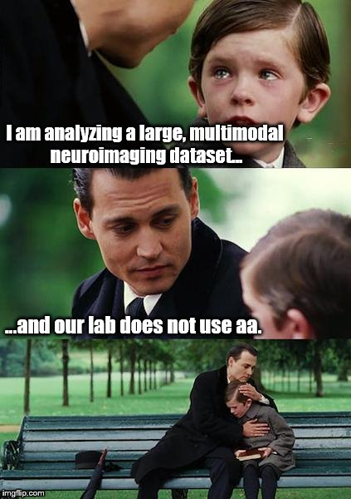
Challenge
Increasingly large cohort sizes
2004: <10
2014: hundreds
Multimodality: fMRI, DWI, anatomy(T1, T2), MTI
Offers a more integrated view of the brain
Requires integration of different methods
↓
Issues:
Difficult integration of methods
Difficult documentation → Reproducibility
Increased risk of human error
Harder to detect errors
Transparency

Slide 3
Solution – Automatic analysis (aa)
Description
A pipeline system for neuroimaging written in Matlab
MRI: structural, fMRI, DTI/DKI, MTI
MEG/EEG
Supports SPM 5/8/12¹ and some functions from FSL and Freesurfer …
Proprietary code from contributors and external scientists
http://automaticanalysis.org
https://github.com/rhodricusack/automaticanalysis/blob/v5-stable/README.md
http://imaging.mrc-cbu.cam.ac.uk/imaging/AA
Availability
GitHub (branch “v5-stable”)
MRC-CBSU – /imaging/local/software/AA/realease-5.1.0
Notes:
Latest SPM12 is highly recommended

Slide 4

Solution – Automatic analysis (aa)
Properties
High-level based on standardised recipes
Automatic, transparent, replicable
Capture provenance
Code recycling/sharing/publishing
Tracks processes → Restartable
Notifies via e-mail
Record keeping → Diagnostics¹
NiFTI-4D support → “Economic”
Notes:
1. Diagnostics = QA

Slide 5
Automatic analysis (aa)
aa-natomy
High-level scripting (examples also bundled)
Automatic, Replicable, Transparent
Code sharing/recycling, Provenance, Publishing
Tasklists: pipelines describing a series of modules to be executed
Easy reading
Easy reordering
Branching
User Master Script: specifies the analysis⁰
Loads in: default parameters and the tasklist
Customises: parameters and tasks
Specifies¹: data and model
Generates³: report
Cleans up⁴: garbage (from data encapsulation)
Notes:
0. Show!!!
Specifies
aas_addsession
aas_addsubject
aas_addevent
aas_addcontrast
aa_doprocessing: Heart of aa!
aa_report
aas_garbagecollection: Eliminates duplicates (encapsulation)

Slide 6
Automatic analysis (aa)
aa-natomy
Images
in dicom format
Convert to format used by SPM (NIFTI)
Initial image diagnostics
Smooth
EPI
Normalise
EPI
Coregister
EPI to structural
Within series processing:
Spatial realignment
Undistortion
Temporal realignment
Normalise structural
Single subject stats
Group stats
Publish…

Slide 7

Automatic analysis (aa)
aa-natomy
autoidentifyseries_timtrio
get_dicom_structural
get_dicom_epi
get_dicom_fieldmap
convert_structural
convert_epis
convert_fieldmaps
fieldmap2VDM
tsdiffana
smooth
norm_write_dartel
norm_write_meanepi_dartel
coreg_extended_2epi
realignunwarp
slicetiming
biascorrect_structural
coreg_extended_1
segment8_multichan
dartel_createtemplate
dartel_norm_write
+
freesurfer_initialise
freesurfer_autorecon_all
firstlevel_model
firstlevel_contrasts
firstlevel_threshold
+
firstlevel_threshold_register2FS
secondlevel_model
secondlevel_contrasts
secondlevel_threshold
+
secondlevel_threshold_register2FS
paper_maker ???

Slide 8
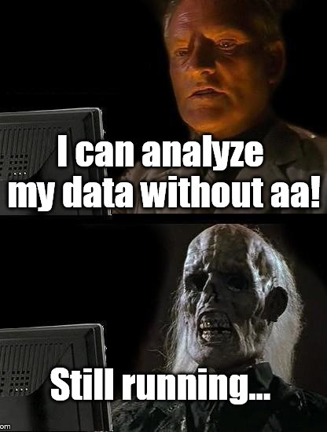
Automatic analysis (aa)
aa-natomy
Modules
Header¹ – Data encapsulation
Defines inputs and outputs (streams)
Defines domain (i.e. once per study/subject/session/scan)
Set parameter defaults²
Ensures independence → Parallel processing on cluster or cloud³
Body⁴ – Code encapsulation
Low overhead, Expandable
Notes:
Show example!
You can overwrite in UMS
Click!
Show example!

Slide 9
Automatic analysis (aa)
aa-natomy
Data streams¹
Modules explicitly define their inputs and outputs.
e.g. (fragment from aamod_realignunwarp.xml)
<inputstreams>
<stream>epi</stream> → Takes a set of EPI volumes
<stream>fieldmap</stream> → and a fieldmap;
</inputstreams>
<outputstreams>
<stream>realignment_parameter</stream> → produces realignment parameters,
<stream>epi</stream> → another set of EPI volumes
<stream>meanepi</stream> → and a mean EPI volume
</outputstreams>
Provenance (flow of data) → parallel computing, report generating
Easy reordering of the modules without worrying for prefixes
Notes:
1. Filename independent

Slide 10
Automatic analysis (aa)
aa-natomy
“Study” features: Diagnostics
Between-subject summaries with descriptive stats to identify outliers
Motion correction
Registration (Normalisation)
First-level activations
Within-subject summary to localize the erroneous stage

Slide 11
Automatic analysis (aa)
aa-natomy
“Large Study” features:
NiFTI-4D format also for SPM-based modules (data maintenance)
Site-/study-specific configuration defaults
Multiple raw data (DICOM) sources¹
Pipeline connection: direct aa streams from a common pipeline
From remote repository to a local machine
From multiple repository (to combine them locally)
Can select only a subset of subjects and sessions
Keeps dependency: pipeline aware of source changes
E.g.:
Multimodal study: separate pipelines for each modality
Complex study: common preprocessing pipeline + multiple models
Notes:
Line 11

Slide 12
Automatic analysis (aa)
aa-natomy
“Large Study” features:
Specification of subjects, sessions and model by means of a text file
Inputfile (sCSV): Subjects and sessions
One file for more analysis
Selected sessions
Easy to add more subjects without coding
Reference Directory template for first-level model (SPM-format)
condition_vol_ID-SessionName.mat
E.g.:
/imaging/ta02/ActionWords/Analysis/E-Prime/S1/condition_vol_S1-Loc.mat
↓
referencedirectory_tmpl = /imaging/ta02/ActionWords/Analysis/E-Prime/*
(“*” will be replaced with ID)

Slide 13

Info/Support
Website: http://automaticanalysis.org
GitHub: https://github.com/rhodricusack/automaticanalysis/blob/v5-stable/README.md
GitWiki: https://github.com/rhodricusack/automaticanalysis/wiki
Our Wiki: http://imaging.mrc-cbu.cam.ac.uk/imaging/AA
Maasters

